Slide 1

DATA INCUBATOR
CAPSTONE PROJECT
On
PEDESTRIAN CRASH DATA ANALYSIS
By
AZHAGAN (AZY) AVR

Slide 2
Motivation
In the US non-motorist are given the right-of-way (ROW) at all instances, even if the motorist is in the ROW.
It is an undeniable fact that the non-motorists are more susceptible to injuries than a motorist, hence the ROW rule.
But with such a rule in place ignorance can also play a part while being a non-motorist and an undue advantage can be taken by a non-motorist.
Hence, I am using a crash dataset to analyze the incidents involving motorists and non-motorists (Pedestrians and Bi-cyclists).

Slide 3
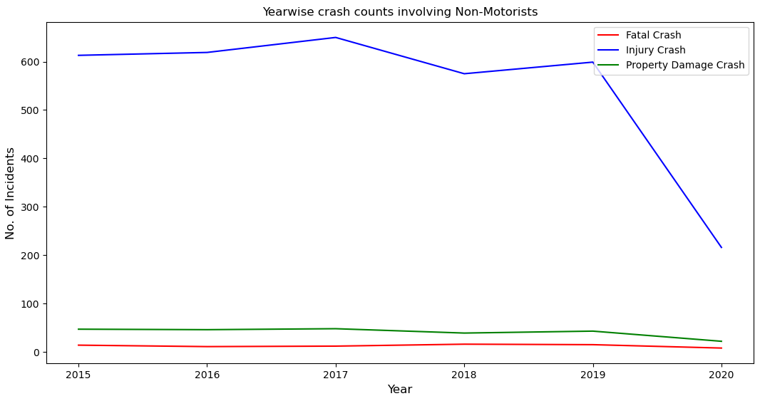
Crash Incidents
The dataset consists of data from 2015 to 2020, for the city of Montgomery in Maryland.
Crash types are classified as:
Fatal crash,
Property damage crash
Injury crash.
All these crashes shown involve pedestrians.
https://data.montgomerycountymd.gov/api/views/n7fk-dce5/rows.csv?accessType=DOWNLOAD

Slide 4
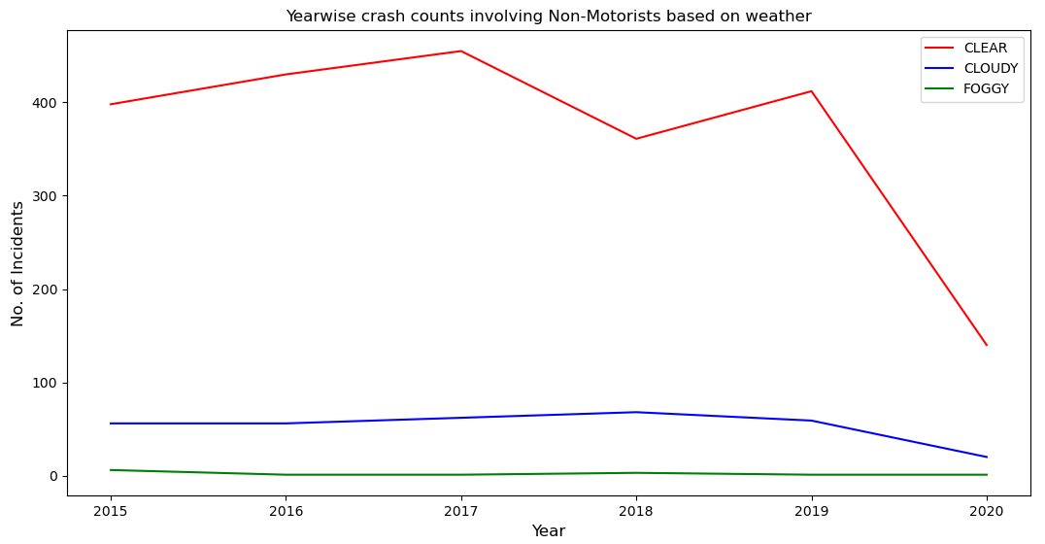
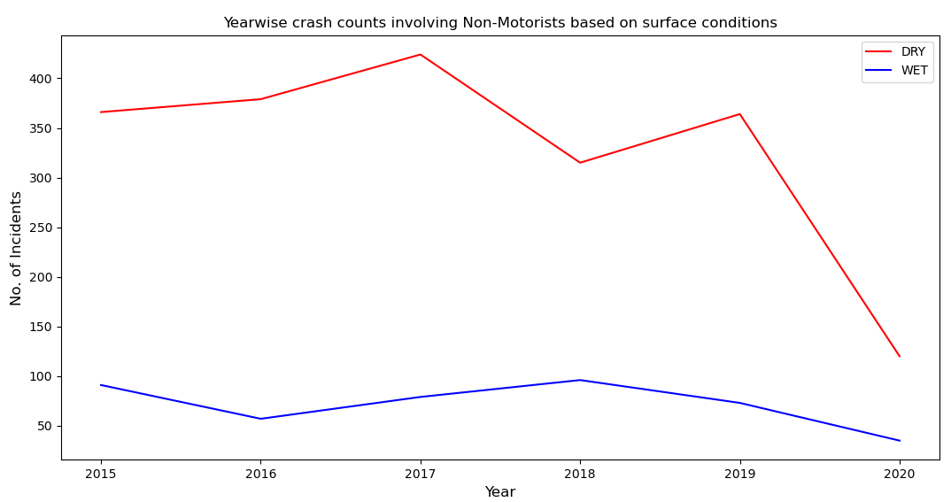
External Factors
WEATHER
A common assumption is that foggy conditions, reduce visibility and crashes tend to increase.
But in case of pedestrian related crashes, a greater number of crashes take place when the skies are clear.
SURFACE
Likewise, more accidents occur on dry roads than wet roads.

Slide 5
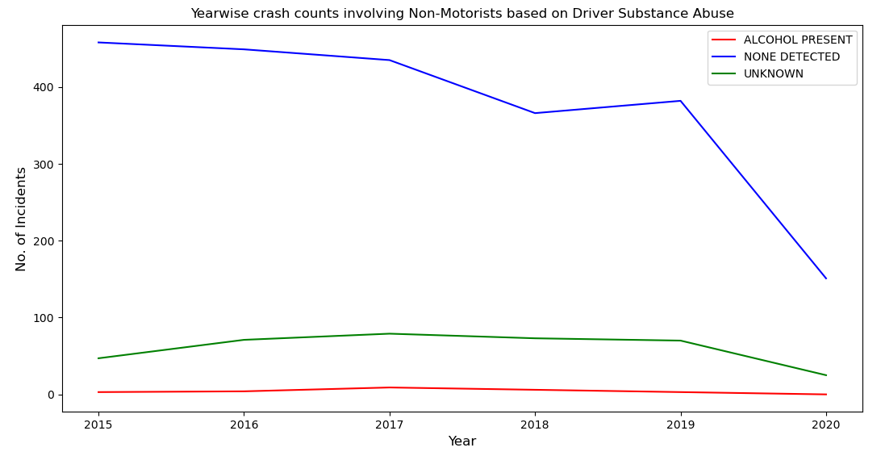
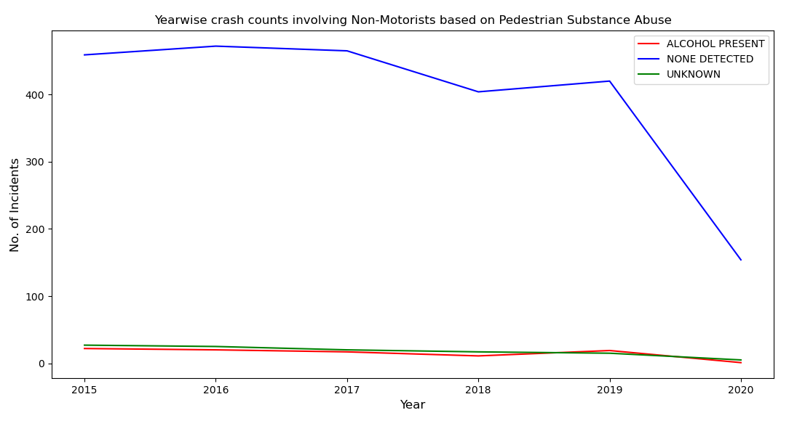
Internal Factors
DRIVER UNDER INFLUENCE
Also another common assumption is that, alcohol consumption might result in high number of crashes.
PEDESTRIAN UNDER INFLUENCE
Both pedestrian and driver substance abuse has very less impact, when compared to cases without substance abuse.

Slide 6
Conclusion
Data is like a mirror that projects the reality.
In this case the external factors like wet roads or foggy weather have least impact on pedestrian related crashes and internal factors like substance abuse have a similar effect.
Hence it is a bit premature to say that this is the case for across the US.
More in-depth research is needed to identify the causes of the pedestrian related crashes.

Slide 7
Future Scope
Location based analysis like, pedestrian at signal or sidewalk or cross walk, etc.
Geospatial information is also available in the dataset, which can be used to identify hotspots.
Data.gov has close to 355 datasets related to pedestrian related crash data.
Analyze data from different cities.
Also would like to explore some predictive and regression techniques to analyze the data.
Tools Used
Pandas
Numpy
Matplotlib

Slide 8
Thank You

